Slide 1


Alpha Phi Omega
Chi Chapter at UCLA
Alpha Lambda / Yuna Choi Term, Meeting 5
April 30, 2014
www.apo-x.org

Slide 2
Agenda
1. Officer Updates and Announcements
2. Chapter Business
3. Last Announcements

Slide 3
President
Jessica Suhardjo
president@apo-x.org
Executive Committee
excomm@apo-x.org

Slide 4
Constitution
https://docs.google.com/document/d/1Kkg-fzWyKGyXAazwgyp8VsasWh3LZlSrwXUHOeAt7Ac/edit

Slide 5
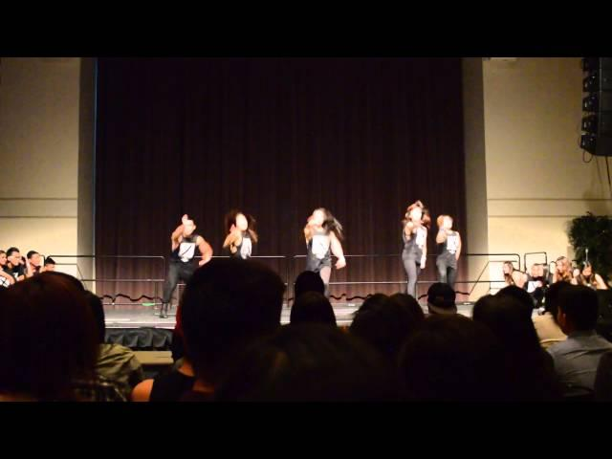

Slide 6
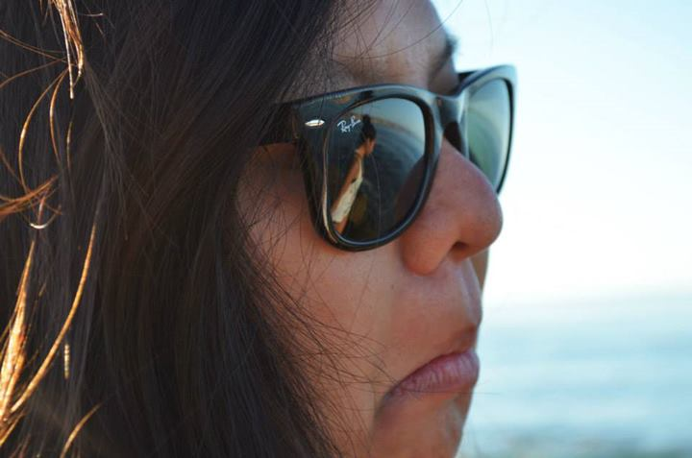
Brothers of Chi Chapter
“After I "take care" of Olivia, I'll finally be the only Brightest Bulb of AZ class…”
Submitted by Andrew Ma

Slide 7
Leadership Workshops
Everything has been tracked!
If there are any issues, please contact me :)

Slide 8
Interviews
Emails
Facebook
Text

Slide 9
Gamer’s Guide Tip #5
“I learned that we can do anything, but we can't do everything... at least not at the same time. So think of your priorities not in terms of what activities you do, but when you do them. Timing is everything.”
- Dan Millman

Slide 10
Administrative VPs
Joseph Chan & Nicola Yip
admin@apo-x.org

Slide 11
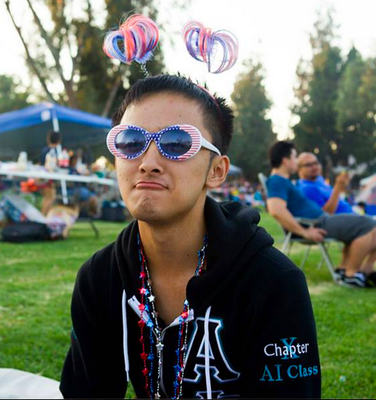
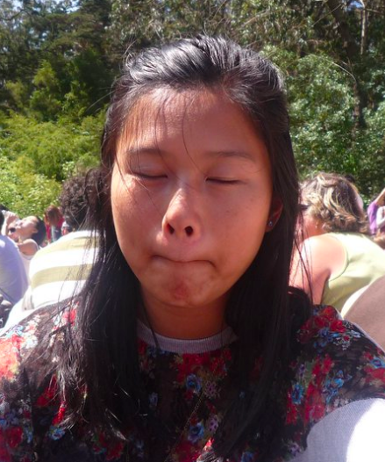
Brothers of Chi Chapter
“All-American Girl”
Submitted by Jeremy Gozzip
“-_-”
Submitted by Brian Lee

Slide 12
Membership VP
Jeremy Gozzip & Melissa Ma
membership@apo-x.org

Slide 13
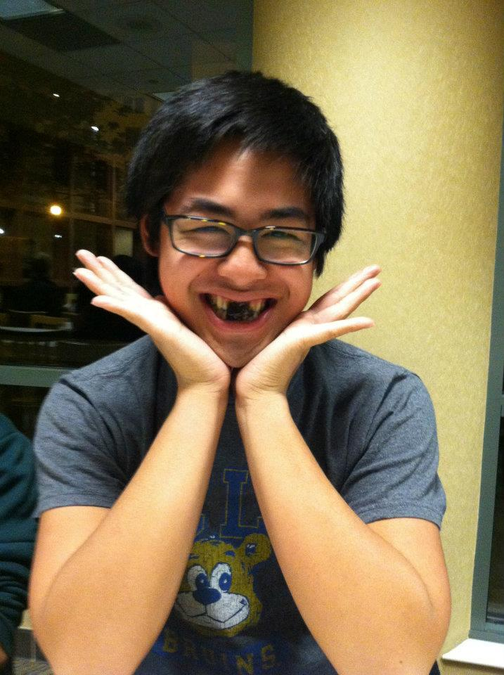
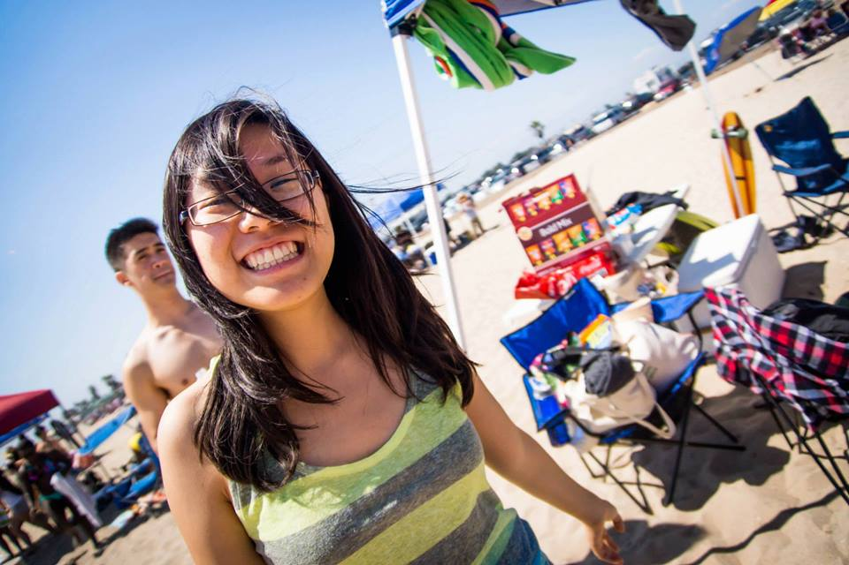
Brothers of Chi Chapter
“He’s not Korean, but I’ll take it.”
Submitted by Jeremy Gozzip
“Talk dirty to me.”
Submitted by Michelle Li

Slide 14

Requirements!
Only a few weeks left!
GET THOSE REQs DONE :D
Active Requirements due CM 8, MAY 23th.
% Actives Completed
50% Chapter Event
25% Service
OOOOH. dasss not guddd~

Slide 15
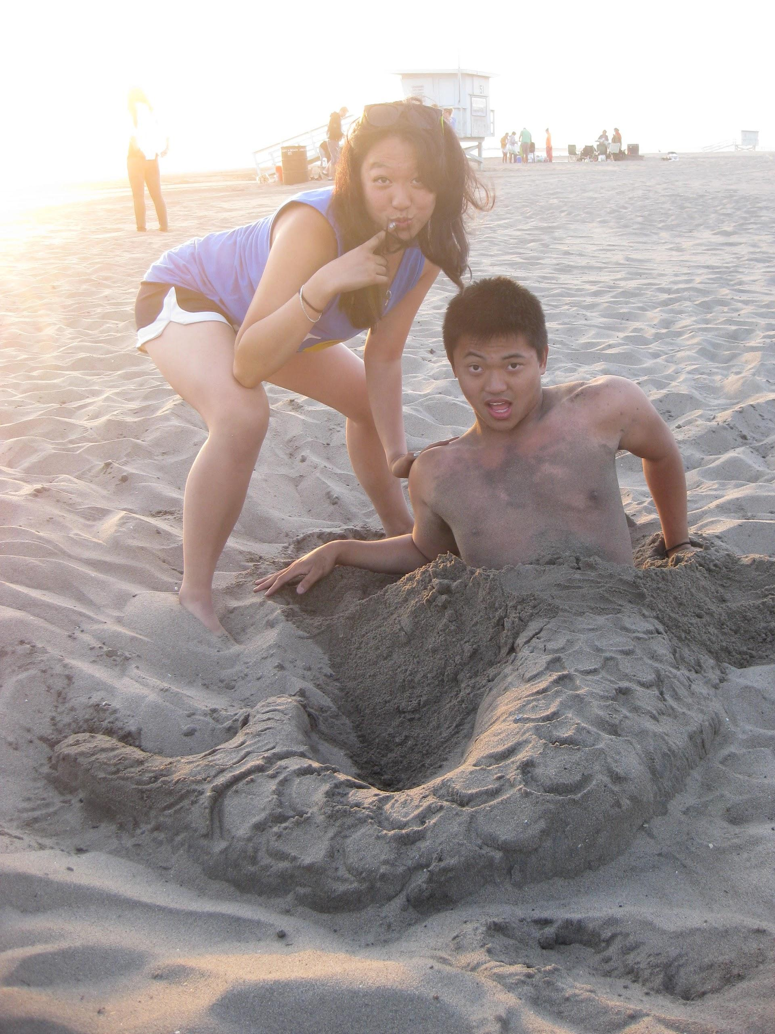
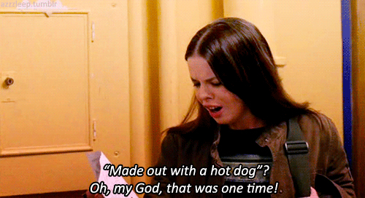
Upcoming!
5/9 Chapter Bonfire
5-9PM.
Get ready to roast dem weeniez.

Slide 16
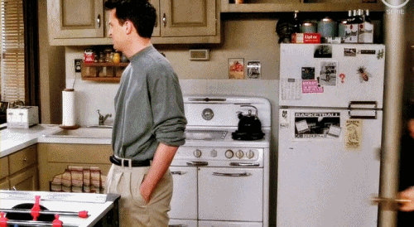
Next Week...
BIG APPRECIATION DAY! :] 5/7

Slide 17
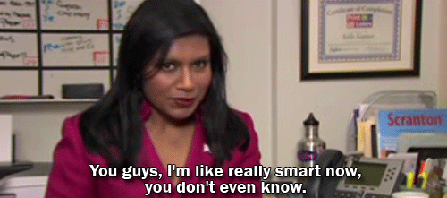
Academic Committee
Please welcome Li Bin Toh and Kristi Su!
ZOMG. yay. they’re awesome!

Slide 18


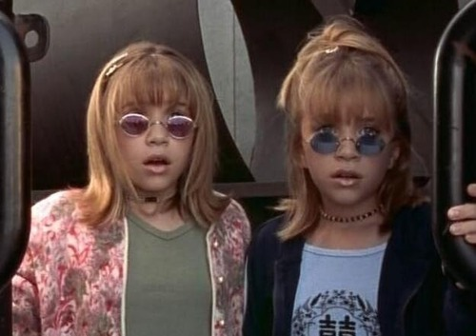
Spirit Day Dress-up?
Twin Day!
#twinning

Slide 19
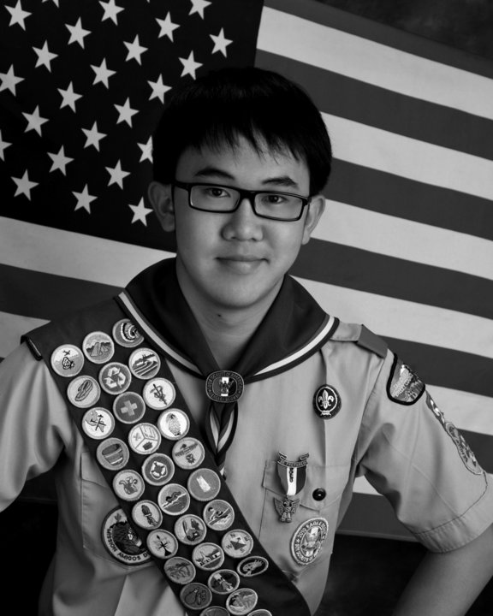
Senior Stoles
Orders are due
By like tomorrow…
kthanxbai. <3
Love,
Brandon Liauw. tehehehe

Slide 20
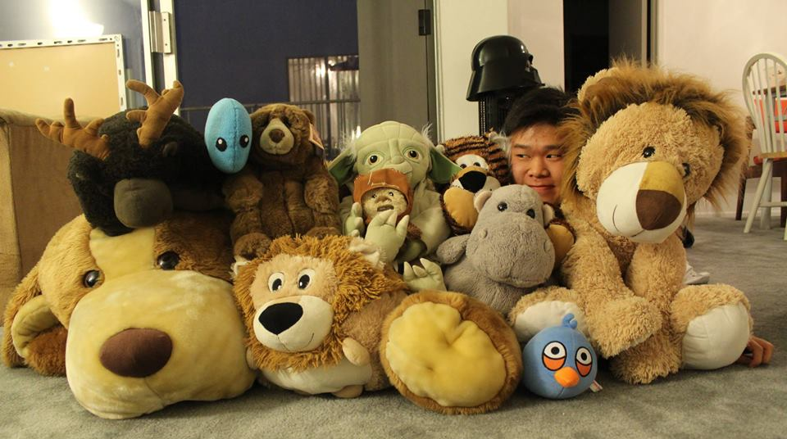
Achievement # 4
LEVEL 4: Neopets! Have 5 people take a photo together w/ each one holding a stuffed animal.
3 class minimum!

Slide 21

Shoutout Book
nice thoughts and recognition for nice ppl.
yeah. that’s it.

Slide 22
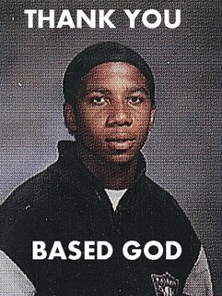
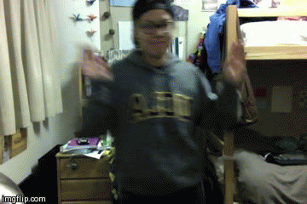
Spirit Committee Game!
YAY.
PRAY TO
BASED GOD
FO’ LUCK ON YO’
MIDTERMS.

Slide 23
Service VPs
William Nguyen & Jade Vo
apoxservice@gmail.com

Slide 24
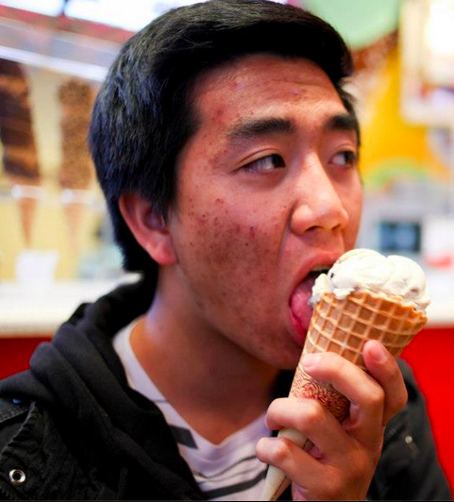
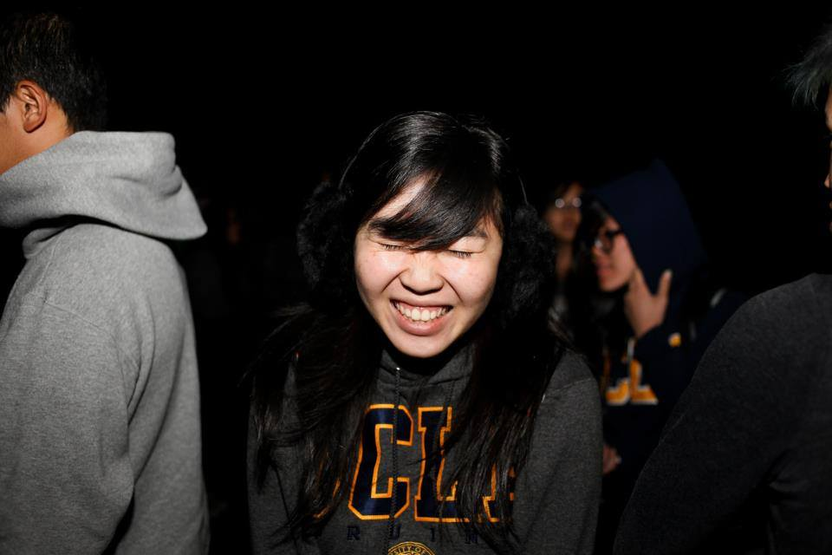
Brothers of Chi Chapter
“*Shart*”
Submitted by Jeremy Gozzip
“Ehh...I’ve licked bigger.”
Submitted by Brandon Liauw

Slide 25


Benefit Concert Updates!
CONFIRMED WITH JOSEPH VINCENT! WAITING FOR DEVIANT VOICES TO REPLY
Random Voices canceled on us, so we will find another A’cappella group to replace them.
There will be a MEET AND GREET with Joseph VINCENT after the CONCERT~ :D

Slide 26
Benefit Concert Update
Poster super tentative!
A little behind schedule… but we will keep you all posted!
Flyering should start next week.
Tell your IC friends to come!
Friendship Bracelets! Ask Jade for supplies!

Slide 27

Relay For Life...
The good
The bad
Suggestions

Slide 28

Other Updates
CHECK THE CALENDAR FOR EVENTS!
WOMP…
COLOR RUN! REGISTRATION INSTRUCTIONS POSTED!
Friendship Bracelets!
Ask Jade for supplies!
Services this weekend! You’re set and registered! (no flakes)

Slide 29
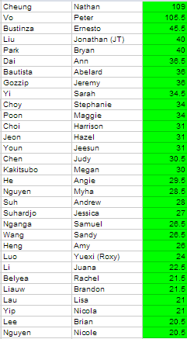

Tracking
TRACKING IS UPDATED AS OF 4/27!

Slide 30
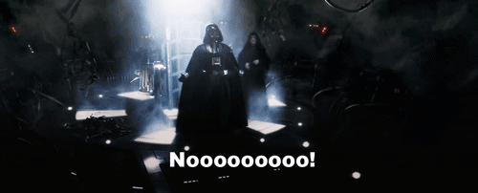
Lots of 0 Hours
For those of you with <5 hours… Jade and I are here to help, especially probationaries! We will contact all probationary actives with less than 5 hours soon via e-mail to discuss how we can help you finish service!

Slide 31
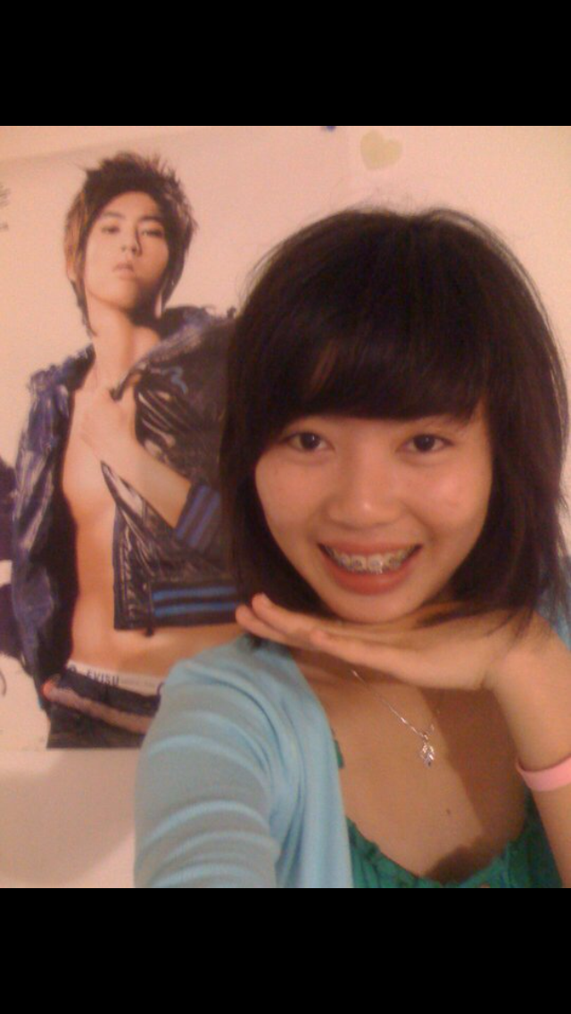
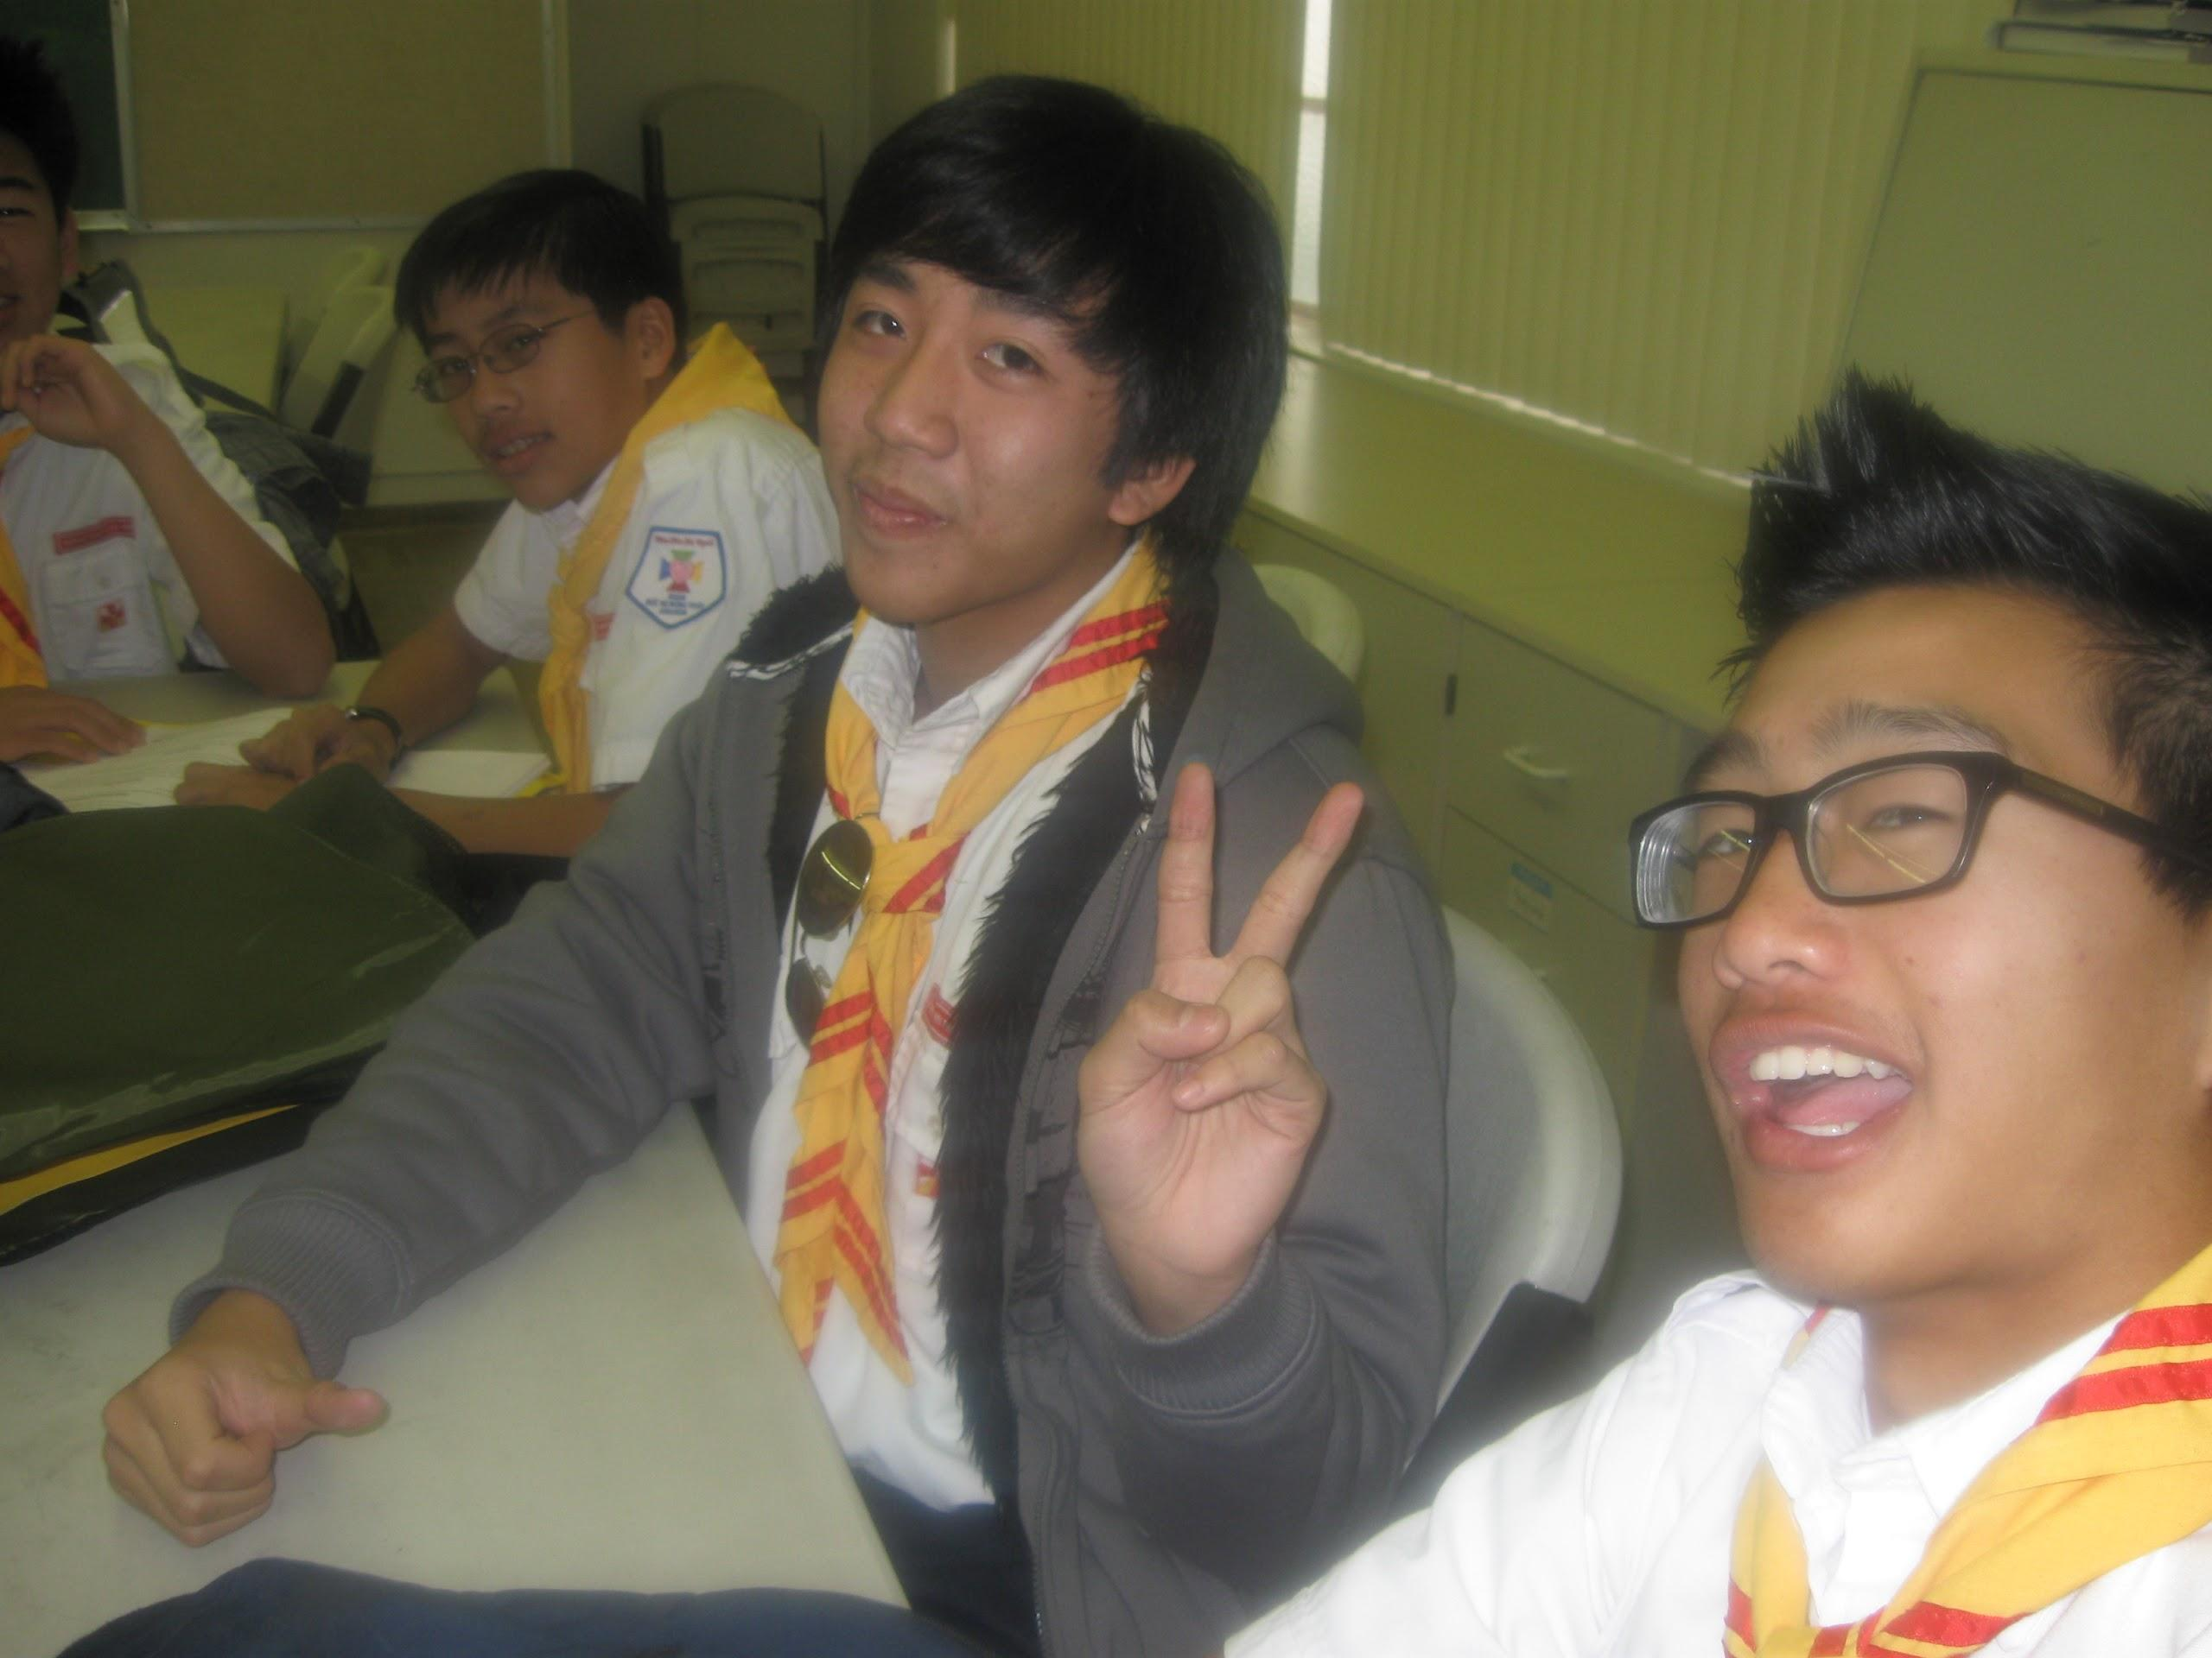
WE PROMISE WE’RE FRIENDLY
We don’t always have resting bitch face... just 99% of the time.

Slide 32

SBotW!
And this week’s SBotW is...

Slide 33
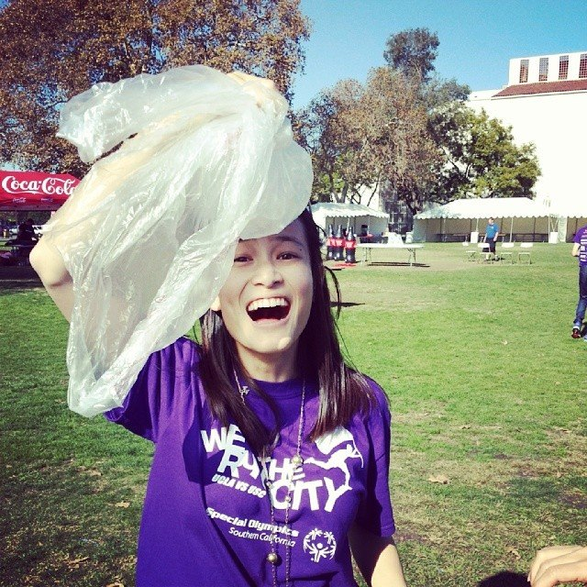
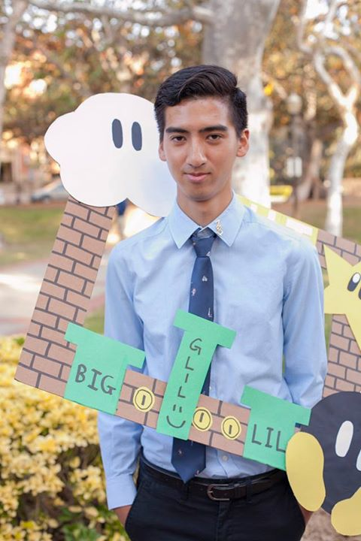

‘ JONATHAN
LIU!
ANGIE HE!

Slide 34

ONE MORE MONTH :)
PLEDGE REQUIREMENTS DUE 5/14
ACTIVE REQUIREMENTS DUE 5/28
FINISH STRONG GUISE
As of this moment, NO MORE SERVICE EVENTS WILL BE ADDED TO THE CALENDAR.

Slide 35
Pledge Parents
Sean Tran & Annie Tran
pledgeparents@apo-x.org

Slide 36
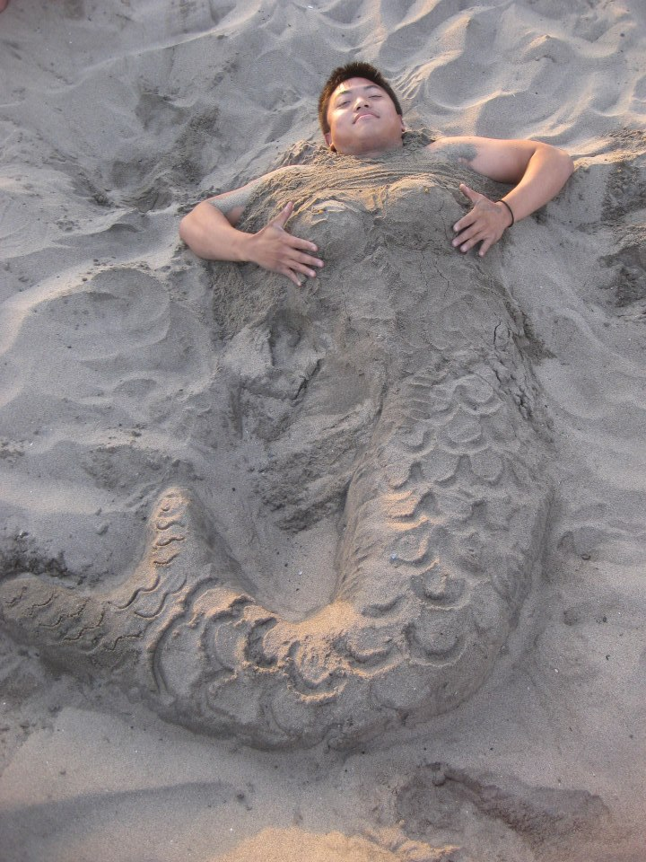
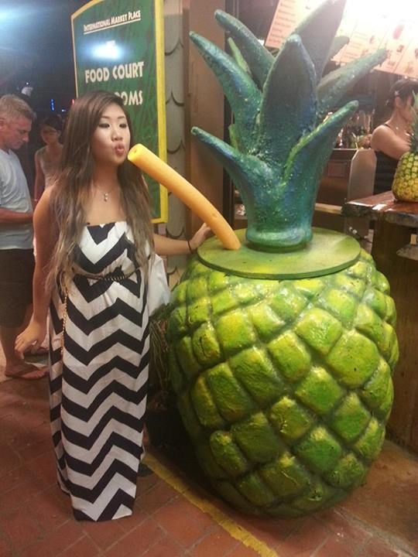
Brothers of Chi Chapter
“My milkshakes bring all the boys to the yard.”
Submitted by Brian Lee
“You know what they say about pineapple juice…”
Submitted by Jeremy Gozzip

Slide 37
Quizzes/Missions
1.Scout oath/law, apo history
2. Airband

Slide 38
INTERVIEW LIST
ARE YOU A REQUIRED SIGNATURE?

Slide 39
Finance VPs
Emily Neai-Proeung & Jonathan Liu
finance@apo-x.org

Slide 40
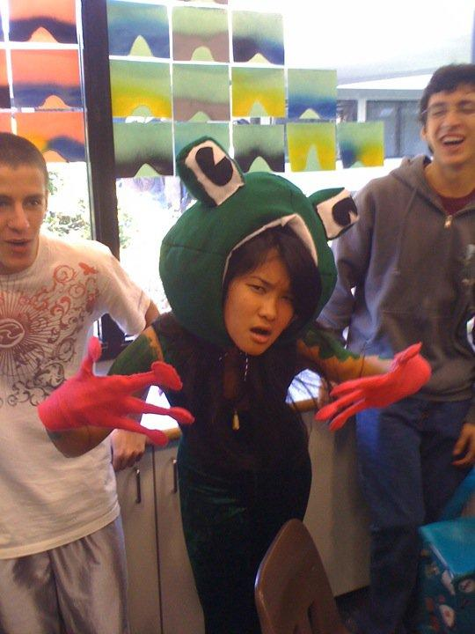
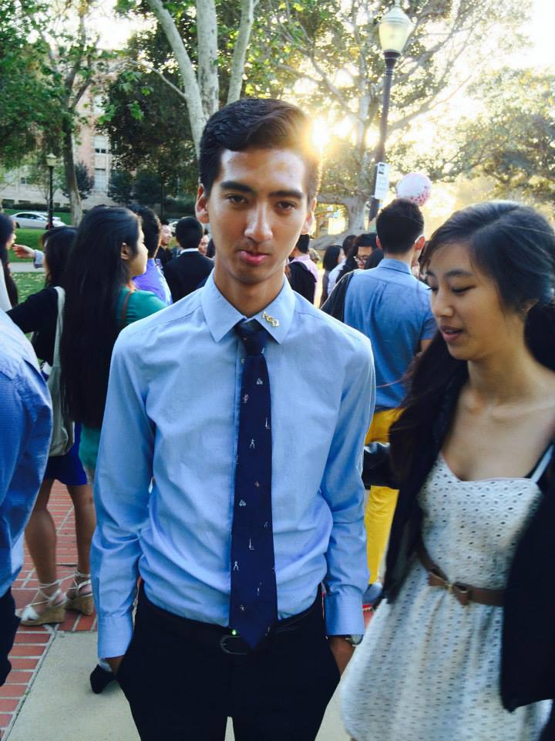
Brothers of Chi Chapter
“Ribbit ribbit, motha f*qqa.”
Submitted by William Nguyen
“I’m so sorry you got Myha.”
Submitted by Tin Tran

Slide 41
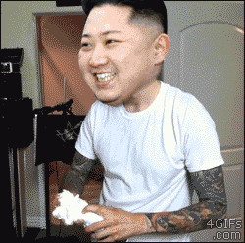
Pie ExComm
*May or may not* be taking place after meeting!
Flake ins welcome!
Great, fun & easy way to fundraise!

Slide 42
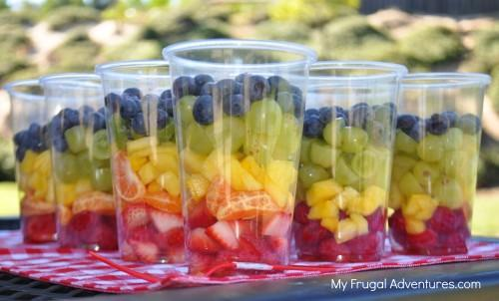
Upcoming fundraisers
Tuesday: Fruit cup sale at North Campus!
Thursday: Game Night!
Friday: TV Taping (“Young & Hungry” at CBS Studios)

Slide 43
Miscellaneous stuff
Let us know if you’re short on fundraising & need help (pledges in particular)!
Tell us if you want to host your own fundraising events/have suggestions for fundraisers!
Eval quicker & give us fundraising money quicker for quicker tracking!

Slide 44
Fellowship VPs
Michael Hung & Dianne Pham
fellowship@apo-x.org

Slide 45
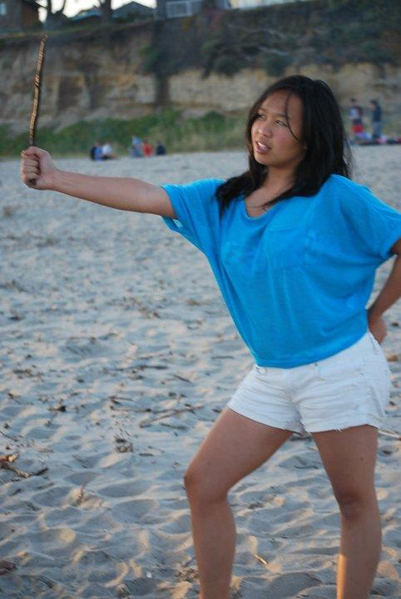
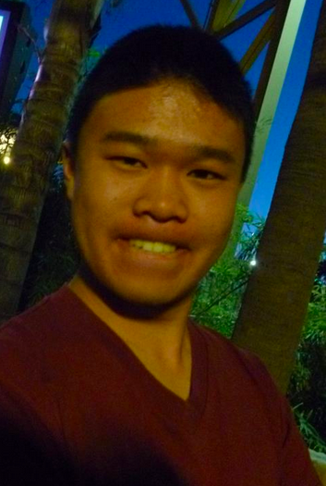
Brothers of Chi Chapter
“It’s leviosa not leviosaaar.”
Submitted by Kevin Quizon
“Hey look, I floss.”
Submitted by Melissa Ma

Slide 46

LGN/TALENT SHOW!!
IT’S THIS FRIDAY.
We have some important details for y’all.

Slide 47
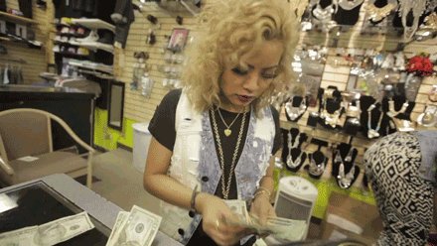
First. PAY UP.
Please pay Angie, Kendrick, Trang, or Jenny after meeting.

Slide 48
The Lobos Truck
1 BURGER (Choose 1)
The Portlander: Hand-crafted veggie patty with grilled onion, tempe bacon, cheddar, vegan meyo, and tomato on a fresh Brioche bun
The Little Nook: ¼ Angus patty with Romaine Lettuce, Tomato, Cheddar Cheese, and a fresh garlic aioli on a fresh sesame seed bun
The BBB: ¼ Angus beef, bleu cheese, bacon
The BBQ Chicken Burger: BBQ chicken, bacon, ranch, romaine lettuce, and tomato
1 SIDE (Choose 1)
Spring Salad
Old Mac
Waffle Fries
1 DRINK

Slide 49
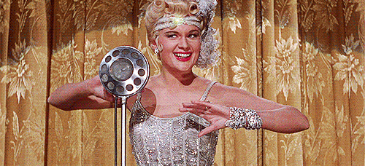
Who is performing?
Currently 7 acts have signed up
Other acts pending!
Please let us know if
you’re still interested!
Email apoxtalentshow@gmail.com

Slide 50

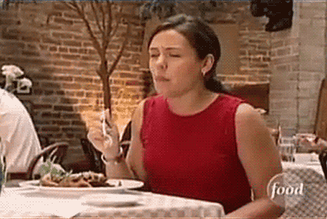
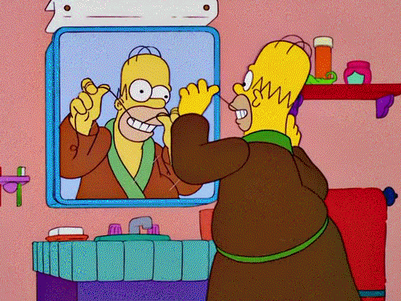
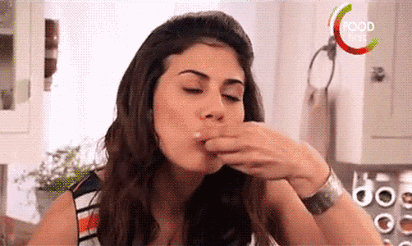
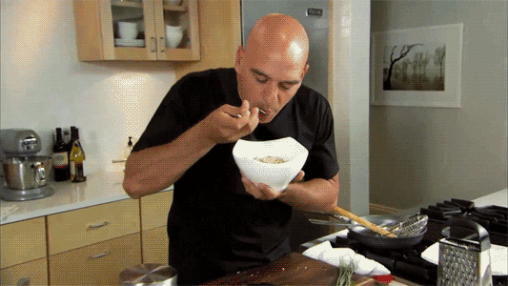

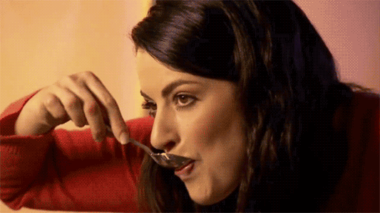
Fun Foursies
Due CM 8, but pledges must complete by CM 7 for credit!

Slide 51

Historian
Tin Tran
historian@apo-x.org

Slide 52
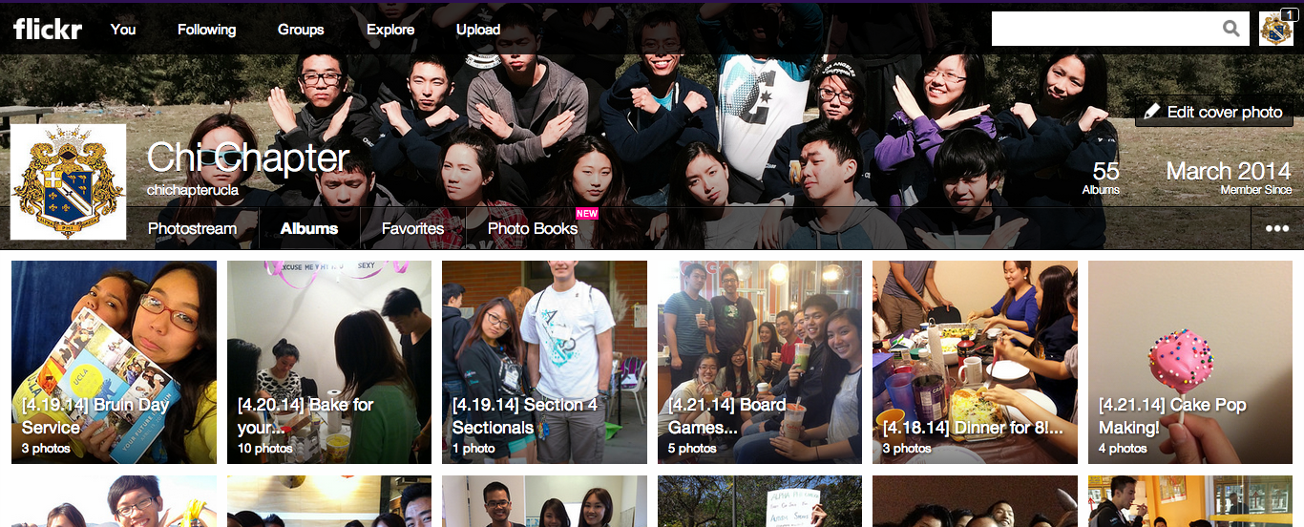

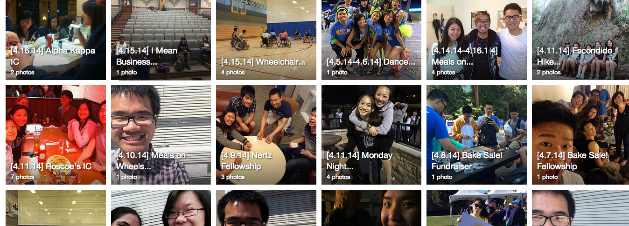
Alpha Lambda Flickr
Completely up to date as of 4/23.

Slide 53
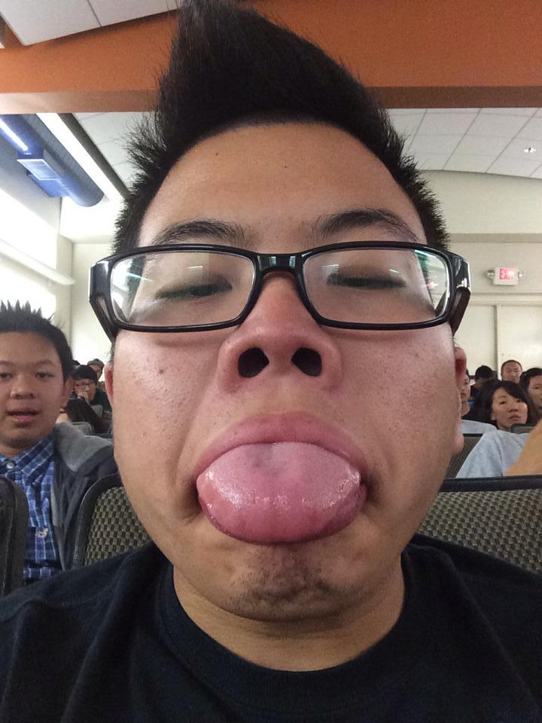
Brothers of Chi Chapter
“ I choose you, Lickitung!”
Submitted by Nina Zhang

Slide 54

Brother of the Week #1
This brother plays the marimba.

Slide 55
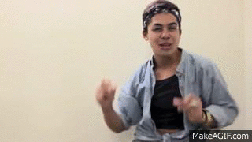
Brother of the Week #1
Jeremy Gozzip

Slide 56

Brother of the Week #2
_____ play?
_____ get some boba?
_____ fanta?

Slide 57
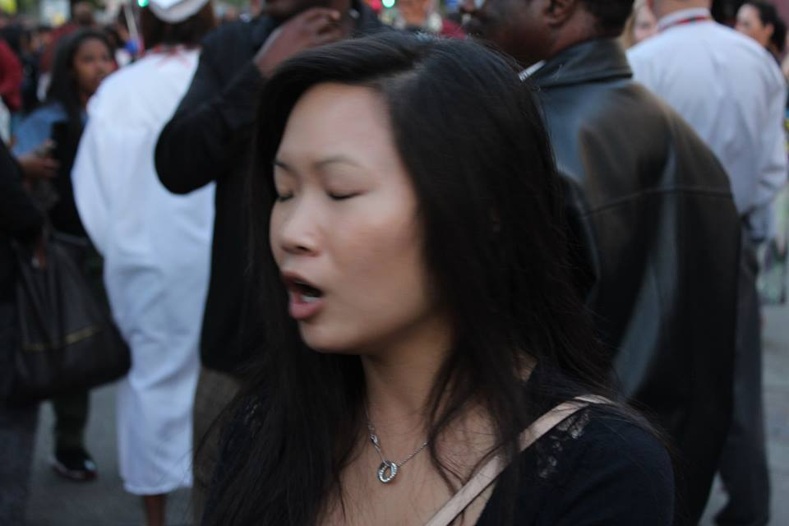
Brother of the Week #2
Juana Li

Slide 58

Chi Trivia
Pledges~
Who are the youngest and oldest
PAC leaders and when did they
pledge?

Slide 59
Chi Trivia
Pledges~
Who are the youngest and oldest
PAC leaders and when did they
pledge?
Maiko Ibay (AI)
Abelard Bautista (AK)

Slide 60

Chi Trivia
Actives~
Who are the youngest and oldest
members in AL EXCOMM
and when did they pledge?

Slide 61
Chi Trivia
Actives~
Who are the youngest and oldest
members in AL EXCOMM
and when did they pledge?
Jonathan Liu (AK)
Kevin Lee (AA)

Slide 62

[YC] Chi Trivia Night
May 21st!
Don’t forget to sign up.

Slide 63

Headshots
Last names A-M, who still haven’t taken it yet.
Last names through N-P

Slide 64

Headshots
Althea Alquitran
Talia Berson
Jessica Bobis
Joseph Chan
Stephanie Choy
Anna Do
Vickie Do
Merry Fu
Holly Fuong
Jeremy Gozzip
Jessie Hsieh
Kristine Huynh
Bo Bae Jeong
Xin Jin
Linda Kang
Jenny Lam
Brian Lee
Ariel Lei
Juana Li
Michelle Li
Sherry Li
Alice Lim
Tracy Lin
Roxy Luo
Vicki Luong
Hamilton Luu
Danny Ly
Melissa Ma
Raymond Mai
Yuki Nakamura
Miye Nakashima
Jae-Ho Nam
Patricia Natalie
Emily Neai-Proeung
Chanel Ng
Samuel Nganga
Cindy Nguyen
Julie Nguyen
Myha Nguyen
Nicole Nguyen
William Nguyen
Jacqueline Pan
Olivia Pardo
Bryan Park
Priya Patel
Dianne Pham
Maggie Poon

Slide 65
Sergeant-at-Arms
Catherine Teotico
apoxsergeant@gmail.com

Slide 66
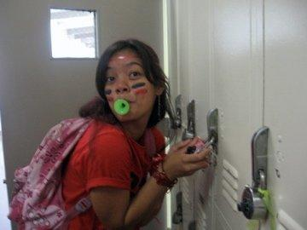
Brothers of Chi Chapter
“Swiper no swiping.”
Submitted by Nicola Yip

Slide 67
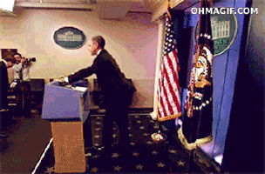

Few Things...
The Attendance/ Strike/ Chairing Trackers are up to date for submission turned in before April 27, 2014. If there any mistakes / makeups you need me to know. Email me ASAP:)
If you have any question about policy. Feel free to email me for clarification.
Elections Are Coming= Parli Pro
WE NEED QUORUM
51 GOOD STANDING

Slide 68

Times A Changing...
America’s Best Evaluation Award
= America’s Best Chair!! ABC!!
We want to acknowledge people for being overall great Chairs instead of just their evaluations…
Submit nominations to apoxsergeant@gmail.com

Slide 69
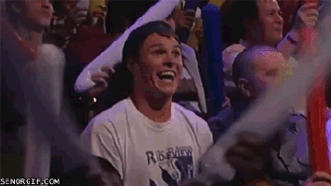
The Winner/s of ABC...

Slide 70
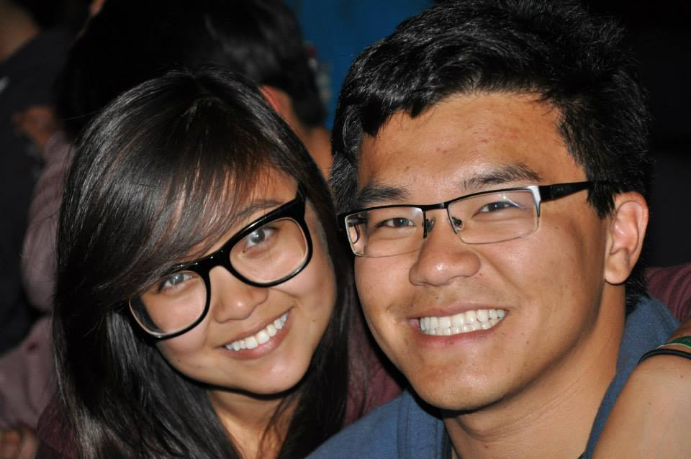

Peter Huang and Julie Nguyen!!

Slide 71
Interchapter Chair
Olivia Pardo
interchapter@apo-x.org

Slide 72

Just a few things...
If you haven’t paid me the $5 admission fee, pay me ASAP. Or I will hunt you down.
Want an ICDC shirt?
Sign up on the calendar! $4

Slide 73
Chapter Business
1. Nominations
2. Last Announcements

Slide 74
Agenda
1. Officer Updates and Announcements
2. Chapter Business
3. Last Announcements

Slide 75
President - Andrew Suh, Raymond Mai
Jeremy Gozzip
Melissa Ma
Danny Ly
Service Vp - Nathan Cheung and Peter Vo
William Nguyen and Hazel Jeon
Jade Vo and Lisa Lau
MVP

Slide 76
Membership VP - Danny Ly and Brian Lee
Ernesto Bustinza and Nathan Cheung
Emily Neai-Proeung and Andrew Suh
Joseph Chan
Brian Martin and Sarah Yi
PParents - Jeremy Gozzip and Emily Neai-Proeung

Slide 77
PParents - Brian Martin and Miye Nakashima
Abram Summers and Maiko Ibay
Melissa Ma and Holly Fuong
Brian Lee and Danny Ly
Admin VP - Patricia Natalie
Lisa Lau
Finance VP - Jonathan Liu

Slide 78
Finance VP - Danny Ly and Abram Summers
Raymond Mai
Fellowship VP - Emily Neai-Proeung and Lisa Lau
Sarah Yi and Abram Summers
Nathan Cheung and Chanel Ng
Harrison Choi and Joanne Kung

Slide 79
Historian - Juana Li
Tin Tran
Christine Lee
Joseph Chan
Patricia Natalie
SAA - Joshua CHin
Danny Ly
Andrew Suh
Ann Dai

Slide 80
IC Chair - San Li, Hazel Jeon, Bowen Lu, Lisa Lau, Chanel Ng, Jeesun Youn, Megan Kakitsubo, Melissa Ma, Danny Ly, Maiko Ibay, Jeremy Gozzip,
CAC - Victor Louie, Yuna Choi, Herumi Ann Baylon, Andrew Ma, Tristan Darvin,

